Slide 1
Pre-Assessment Questions
  How many types of columns can be created for a DataGrid control?
    3
    2
    4
    1
  Which of the following events is supported by the Repeater control?
    ItemCreated
    EditCommand
    UpdateCommand
    DeleteCommand

Slide 2
Pre-Assessment Questions (Contd.)
  The ______________ class provides a forward-only way of generating streams or files containing XML data that conforms to W3C XML 1.0.
    XMLTextWriter
    XSLTransform
    XMLTextReader
    XMLNodeReader
  Which of the following is a property of the XML Web server control?
    TransformSource
    XMLDocumentType
    XMLElement
    XMLAttribute

Slide 3
Pre-Assessment Questions (Contd.)
  Identify the correct statement.
    The FREETEXTTABLE function returns a resultset containg the columns of a table.
    The FREETEXT predicate returns the records that match the words in the search string.
    The CONTAINS predicate accepts the search phrase as a parameter.
    The CONTAINSTABLE function accepts two parameters, the table to search and the search phrase.

Slide 4
Solutions to Pre-Assessment Questions
  c. 4
  a. ItemCreated
  a. XMLTextWriter
  a. TransformSource
  b. The FREETEXT predicate returns the records that match the words in the search string.

Slide 5
Objectives
  In this lesson, you will learn to:
    Create a Web Service
    Invoke a Web Service from a Web Application
    Invoke a COM/COM+ component from a Web application
    Invoke an ActiveX component from a Web application
    Create a multi-tier application

Slide 6
Need For Web Services
  A Web service exposes a number of methods to provide functions that can be used by one or more applications, regardless of the programming languages, operating systems, and hardware platforms used to develop them.
  Web Services provide the following benefits:
    Easy accessibility
    Flexibility in structure
    Easy Integration
  A Web Service has the following elements:
    Extensible Markup Language (XML)
    Simple Object Access Protocol (SOAP)
    Web Services Description Language (WSDL)
    Universal Description, Discovery and Integration (UDDI)

Slide 7
Creating and Invoking a Web Services
  Perform the following steps for creating a Web Service:
    Select the Start→Programs→Microsoft Visual Studio .NET 2003→ Microsoft Visual Studio .NET 2003 command to open the Start Page of the Visual Studio .NET IDE.
    Select Visual C# projects from the Project Types pane and ASP.NET Web Service from the Templates pane in the New Project dialog box.
    Type http://localhost/<folder name> in the Location textbox. Click the OK button.

Slide 8
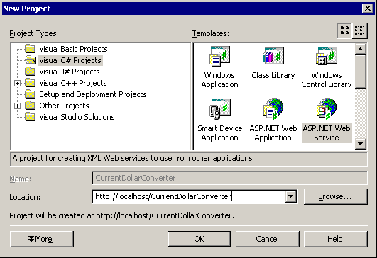
Creating and Invoking Web Services (Contd.)
New Project dialog box

Slide 9
Creating and Invoking Web Services (Contd.)
  Right-click <Application.asmx file> in the Solution Explorer and from the dropdown menu, select View Code to open the <Application.asmx.cs> file. The code window appears.
  Add the code inside the Service1.asmx.cs Class, in the code window as shown in the following example:
  [WebMethod] public double ConvertValue(double Value)
  {//Converting Dollars to Euro
  return Value*0.81;
  }
  To build the application, select the Build→Build solution command.

Slide 10
Creating and Invoking Web Services (Contd.)
  After creating the Web service, you need to test it to ensure that it functions properly.
  Perform the following steps to test the Web Service:
    Right-click the <Application.asmx> file in the Solution Explorer and select Preview in browser or press F5.
    The Web Service page is displayed as shown in the following figure. The following figure displays a Web service that is exposing its method ConvertValue. This method accepts Value as parameter of double data type.

Slide 11
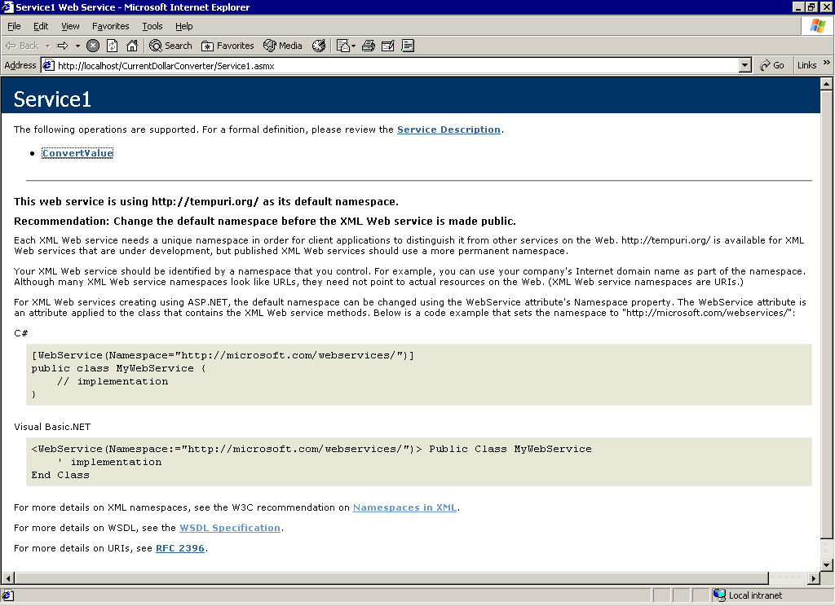
  Creating and Invoking Web Services (Contd.)

Slide 12
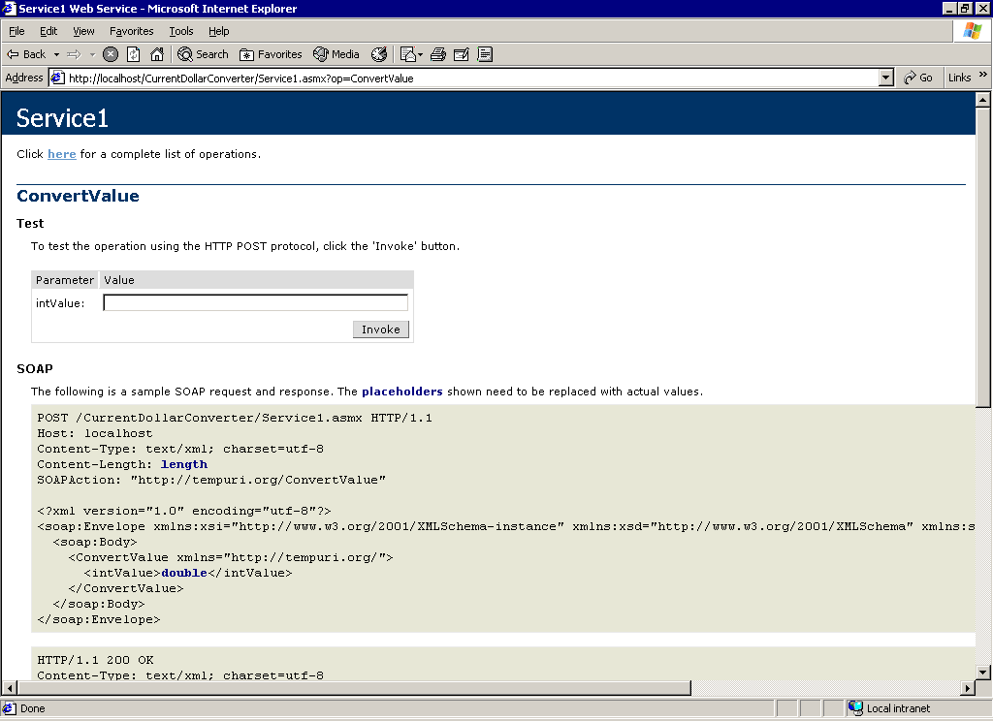
  Creating and Invoking Web Services (Contd.)
    Click the <method> link.
    In the test page, enter the parameters for the method and execute the Web service.
    The following figure shows the test page:

Slide 13
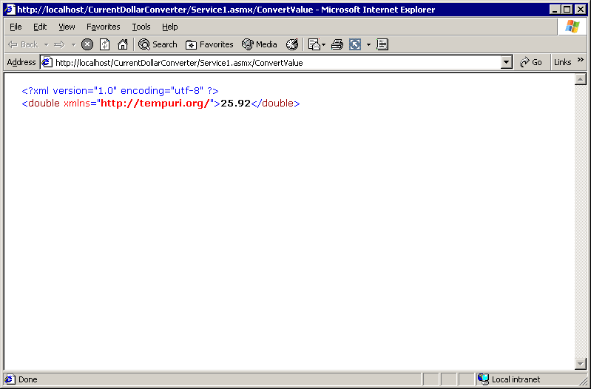
  Creating and Invoking Web Services (Contd.)
    The result will appear as shown in the following figure:
Output Page

Slide 14
  Creating and Invoking Web Services (Contd.)
  You need to perform the following steps to invoke the Web Service:
    Create a new Visual C# projects. Ensure to select ASP.NET Web Service from the Templates pane.
    In the Solution Explorer, right-click on the <application name> and select Add Web Reference.

Slide 15
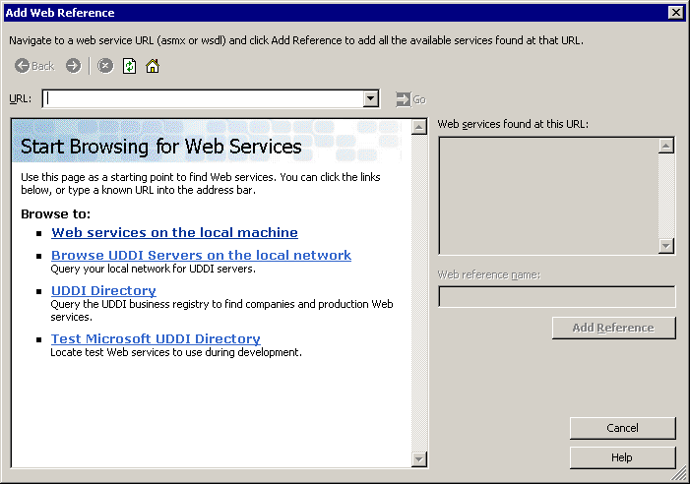
Creating and Invoking Web Services (Contd.)
    The following dialog box gets displayed:

Slide 16
Creating and Invoking Web Services (Contd.)
    In the Add Web Reference dialog box, select the web service name.
    To add the reference, click the Web services on the local machine option
    The existing services on the local machine will appear as following:

Slide 17
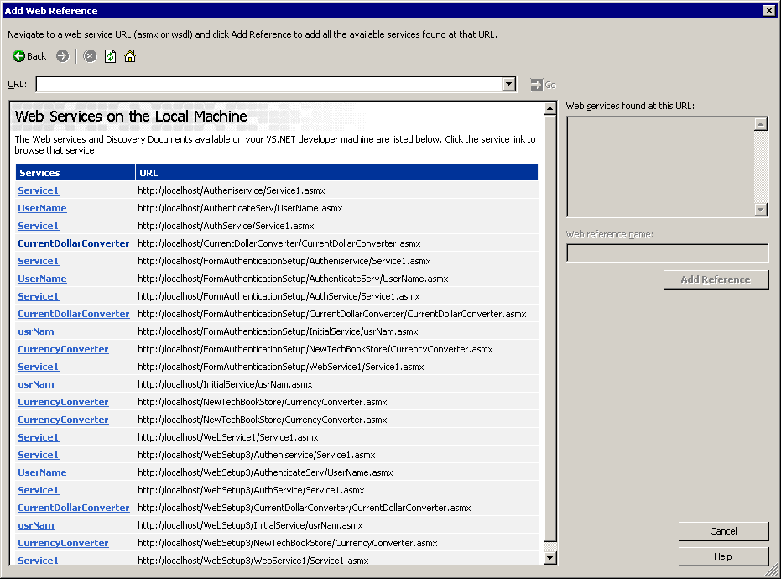
Creating and Invoking Web Services (Contd.)

Slide 18
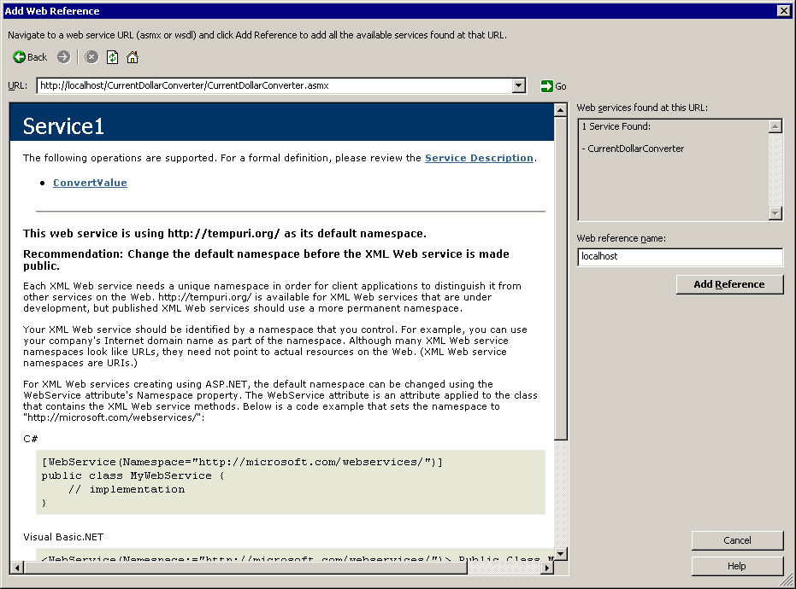
Creating and Invoking Web Services (Contd.)
  Click the Web Service name service. The Add Reference button is activated as shown in the following figure:

Slide 19
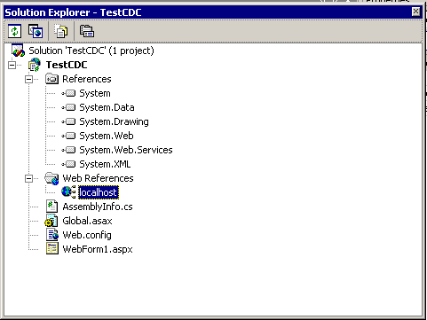
Creating and Invoking Web Services (Contd.)
  Click the Add Reference button. A new localhost is added under the References node in the Solution Explorer as shown in the following figure:

Slide 20
Creating and Invoking Web Services (Contd.)
  In the Design view of the Web form, select the controls, like Textbox, Label, Buttons, and place them on the Web form and change the properties.
  Add the following code in Button1_Click event handler to use the Web service as shown in the following example:
  void BtnConvert_Click(object sender, System.EventArgs e)
  {
  int intTmp;
  //declaring object of the Web service class
  Test CDC.localhost.currentDollarConverter obj=new
  TestCDC.localhost.currentDollarConverter();
  //invoking web method ConvertValue
  intTmp=obj.ConvertValue(Convert.ToInt32(txtDollar.Text));
  //displaying output in label
  lblOutput.Text=”The Value in Rupees is: “+intTmp;}

Slide 21
Creating and Invoking Web Services (Contd.)
  To save the application, select the File→Save Project option.
  To run the application, select the Debug→Start option.

Slide 22
Invoking COM/COM+ and ActiveX Components
  In .NET, all codes are executed within the Common Language Runtime (CLR) environment.
  The Common Object Model (COM) components are developed in unmanaged language and are not executed by the CLR.
  .NET provides a feature called interoperability, which makes it possible to use COM components within an ASP.NET application.
  When an ASP.NET application calls a COM component, a wrapper is created by CLR around the object, known as Runtime-Callable Wrapper (RCW).
  RCW accepts incoming requests from ASP.NET application and translates them so that the COM+ component can understand them and pass them onto the COM component.

Slide 23
Invoking COM/COM+ and ActiveX Components (Contd.)
  For example, to add a COM component, perform the following steps:
    Select the Start→Programs→Microsoft Visual Studio .NET 2003→ Microsoft Visual Studio .NET 2003 command to open the Start Page of the Visual Studio .NET IDE.
    Select Visual C# projects from the Project Types pane and ASP.NET Web Service from the Templates pane in the New Project dialog box and click the OK button.
    Select Project → Add References.

Slide 24
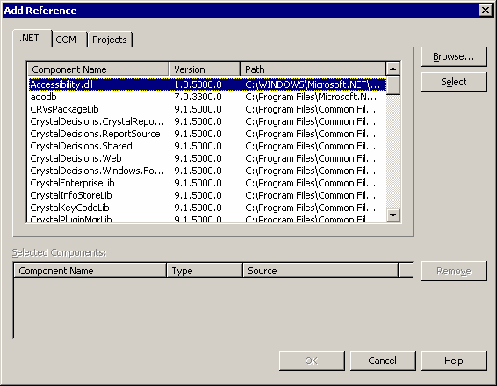
Invoking COM/COM+ and ActiveX Components (Contd.)
    The Add Reference dialog box is displayed below:

Slide 25
Invoking COM/COM+ and ActiveX Components (Contd.)
  Select the COM tab in the Add Reference dialog box.
    A list of available COM components are displayed.
  Select Microsoft ActiveX Data Objects Recordset 2.7 Library from the list and click the Select button.
    The component is added to the Selected Components pane, this is displayed in the following figure:

Slide 26
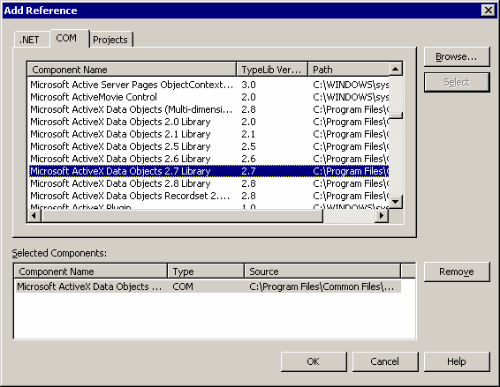
Invoking COM/COM+ and ActiveX Components (Contd.)
Add Reference Dialog Box

Slide 27
Invoking COM/COM+ and ActiveX Components (Contd.)
  Click the OK button to close the Add Reference dialog box.
  The component that you have added to the project is displayed in the Reference node in the Solution Explorer.
  You can use the COM component in the application by specifying its library and class, as shown in the following code snippet:
  ADODB.RecordsetClass rs = new ADODB.RecordsetClass();

Slide 28
Invoking COM/COM+ and ActiveX Components (Contd.)
  Invoking ActiveX control is much like invoking COM components, but invoking ActiveX involves handling events.
  The following steps invoke a sample ActiveX Control using the VS.NET IDE:
    In the Toolbox, select the Components tab.
    Right-click the Toolbox. Select Add/Remove Items from the dropdown menu. The Customize ToolBox is displayed.
    Click the COM Components tab, scroll down, and then select the ActiveX control you want to use in the application and Click OK.
    Drag and drop this control onto the Web form.

Slide 29
Creating a Multi-Tier Web Application
  A multi-tier application is one in which COM components are used to divide a Web application into multiple layers.
  The benefit behind this is that it increases manageability and maintenance of the application.
  It also makes it feasible for multiple teams of programmers to work on the same application at the same time.

Slide 30
Demonstration-Creating a Multi-Tier Application and Executing It
  Problem Statement
    BooksTreasure Inc. has an online bookshop, where users place order for books. The Company requires an application to be created, which should authenticate the user by checking the existence of the user in the database. You have been asked to develop a multi-tier application as it increases the manageability and maintenance of the application. Moreover, the application should ensure that any change in the database should not affect the user interface.
    Hint: Use the Description table from the Webshoppe database.

Slide 31
Demonstration-Creating a Multi-Tier Application and Executing It (Contd.)
  Solution
    1. Identify the data required to authenticate the user.
    2. Create the business logic to authenticate the user.
    3. Design the Web form for the presentation layer to input the data.
    4. Run the application.

Slide 32
Summary
In this lesson, you learned:
  A Web service exposes a number of methods to provide functions that can be used by one or more applications, regardless of the programming languages, operating systems, and hardware platforms used to develop them.
  An application that uses a Web service is called a Web service client.
  Web services provide the following benefits:
    Easy accessibility
    Flexibility in structure
    Easy integration
  A Web service has the following elements:
    XML
    SOAP
    WSDL
    UDDI
  Component Object Model (COM) is a language-independent architecture that defines specifications for component interoperability.

Slide 33
Summary (Contd.)
      Each COM component is identified by a Globally Unique ID.
      ASP.NET supports COM+ for backward compatibility
      When an ASP.NET application uses a COM+ object, a wrapper is created around the object.
      The wrapper that allows interaction between COM and ASP.NET is called Runtime‑Callable Wrapper (RCW).
      The information exchanged between a COM component and a .NET component is marshaled by the RCW.
      Multi-tier applications helps in easy manageability and maintenance.

